Slide 1
CMP Process Automation
Streamline Course Content Production for Brightspace

Slide 2







Executive Summary
Current Challenges
Manual processing: 5 hours per LO document*
Inconsistent formatting across LOs
Error-prone manual styling process
Proposed Solution
Automated n8n workflow processing
Standardized Sask Polytech styling
Intelligent section detection & splitting
Integrated media request management
Expected Impact
80% reduction in document processing time
100% consistent styling
1.0 FTE annual cost saving
< 1 minute
> 90%
2,500
$70,000
Processing time
Success rate
Documents per month
Annual savings
* The average number of hours for CMPs to process one LO document for AY 2024-2045 is 5.1

Slide 3
Current vs. Proposed
Current Process
ID creates a Word doc for each LO
CMP receives the Word doc and manually copies and paste content to Dreamweaver. Sections in Word doc are manually split to individual HTML documents. This is where CMP spends most of their time.
CMP uploads HTML documents to Brightspace
Proposed Process
ID creates a Word doc for each LO
CMP receives the Word doc and run a command line to convert Word to a single HTML document.
CMP upload the HTML document to a web interface, which automatically generates individual HTML documents with Sask Polytech global styles applied.
CMP uploads HTML documents to Brightspace

Slide 4



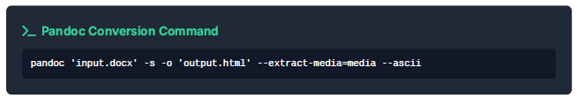
Three-Step Workflow Process
Document Preparation
Format with h1 heading structure
Add style tags for activities
Include media requests
HTML Conversion
Convert Word to HTML using Pandoc
Single command execution
Extract media automatically
Automated Process
Upload LO HTML to web interface
Automatic section detection
Automatic SP style application
Download Brightspace-ready files

Slide 7

Smart Document Structure Recognition
Automatic Section Detection
Learning Outcome Into:
1.0.0 01_00_00_intro.html
Learning Steps:
1.1.0 01_01_00_getting_started.html
Learning Activities:
1.1.1 Discussion 01_01_01_discussion.html
Key Benefits
Consistent file naming across the whole course
Automatic categorization by content type
Placeholder for media/interactives
Ready for immediate Brightspace upload

Slide 8
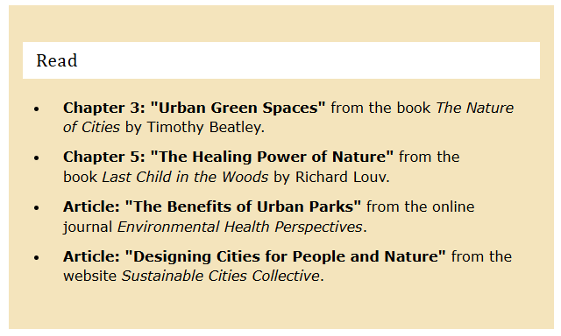
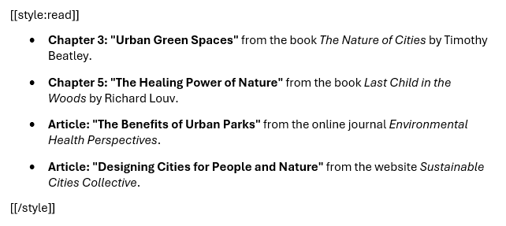

Comprehensive and Intuitive Style Tag System
Activity Types
[[style:read]] Reading activities
[[style:watch]] Video activities
[[style:assignment]] Assignment
[[style:discussion]] Discussion
Media & Images
[[style:image]] Image with citation
[[style:imageLeft]] Left float
[[style:imageRight]] Right float
Specialized Content
[[style:transcript]]
[[style:code]]
[[style:note]]
Result
Professional, consistent appearance across all course materials with automated Sask Polytech branding

Slide 9







Robust Technical Architecture
Webhook Trigger Receives HTML uploads
Process Upload Validate & Extracts content
Parse Sections Intelligent Section Detection
Generate HTMLs Create files with styling
Final Response Preview and download
Production-Ready Features
Comprehensive error handling with detailed feedback
Content validation (size limits, format checking)
Advanced debugging capabilities
Try-catch blocks in all processing nodes
Performance Metrics
Processing time: < 1 minute per file
Success rate: > 90%
Maximum 100 H1 sections per document
5 MB per section, 10MB total limits

Slide 10

Quantifiable Benefit & ROI
Time Savings
90%
Process time reduction
Quality Improvements
100%
Consistent formatting
Cost Savings
$70,000
Estimated annual savings
From 5 hours to < 5 minute
Zero styling errors
Standardized automatic file organization
Increased productivity

Slide 11



User Training & Adoption Plan
For Instructional Designers
1-hour training on style tag usage
Quick reference guide for document formatting
Template document for common course activity types
For CMPs
30-minute training for web interface
Hands-on practice with sample documents
Troubleshooting guide for commons issues
User Manual
Template Document
Group Channels

Slide 12
Implementation Roadmap
Phase 1: Immediate (2 weeks)
Management approval and sign off
Production server deployment
Initial CMP training sessions
Phase 2: CMP Pilot (1 month)
Pilot with 3-5 courses with CMPs
Gather feedback and optimize
Phase 3: ID Pilot and rollout (1
month)
IDs to adopt the new styles
Gather feedback and optimize
Advanced feature planning

Slide 13
Success Metrics & Monitoring
Performance Indicators
Process Time: < 1 minutes
Success Rate: > 90%
User Adoption: 100%
Quality Score: zero errors
ROI Measurement
Time savings (Track processing time before and after)
Cost Reduction/Increased Productivity
Quality Metrics
User Satisfaction
Investment Summary
$0
Development Costs
(Completed internally)
$100/month
Operational Cost
(n8n and AI subscriptions)
1 week
ROI timeline
(Break-even time)

Slide 14







































Resource Page
Use these design resources in your Canva Presentation.
FONTS
DESIGN ELEMENTS
This presentation template
uses the following free fonts:
TITLES:
INTER
HEADERS:
INTER
BODY COPY:
INTER
You can find these fonts online too.
COLORS
#C2D076
#FFFFEE
#001514
DON'T FORGET TO DELETE THIS PAGE BEFORE PRESENTING.

Slide 15

Credits
This presentation template is free for everyone to use thanks to the following:
for the presentation template
Pexels, Pixabay
for the photos
Happy designing!

